Slide 1
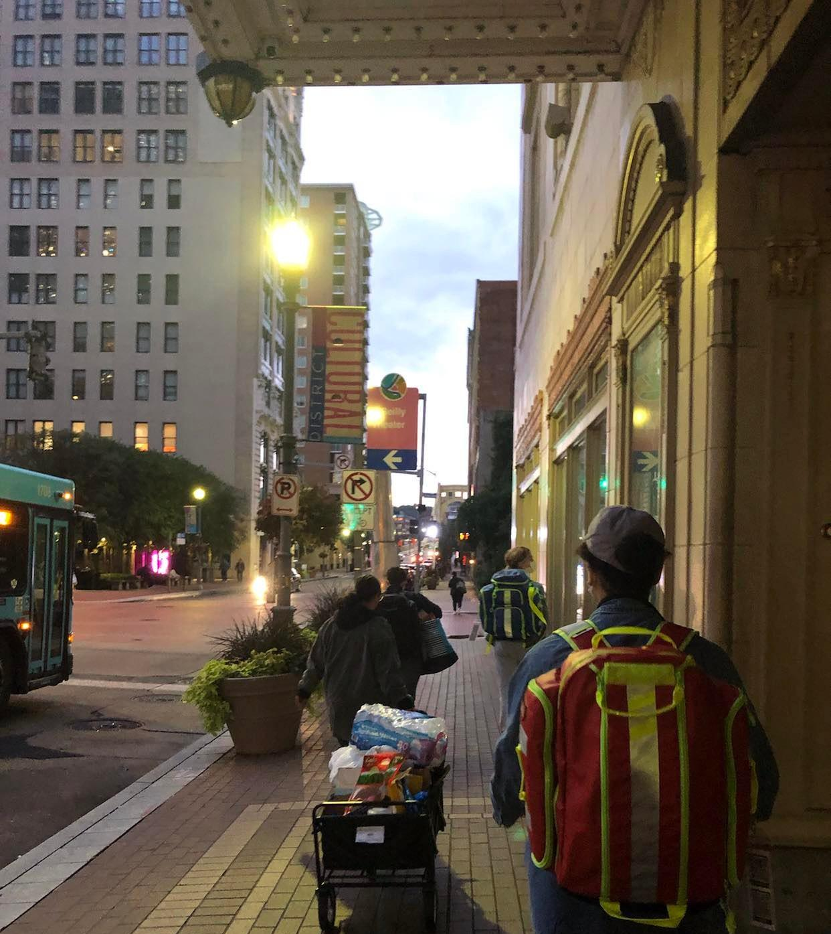
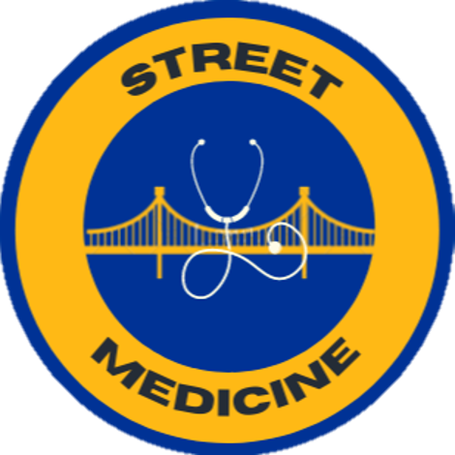
Street Medicine at Pitt
September 16, 2025 Event
A student-led interdisciplinary organization supporting the unhoused community in Pittsburgh, PA

Slide 2
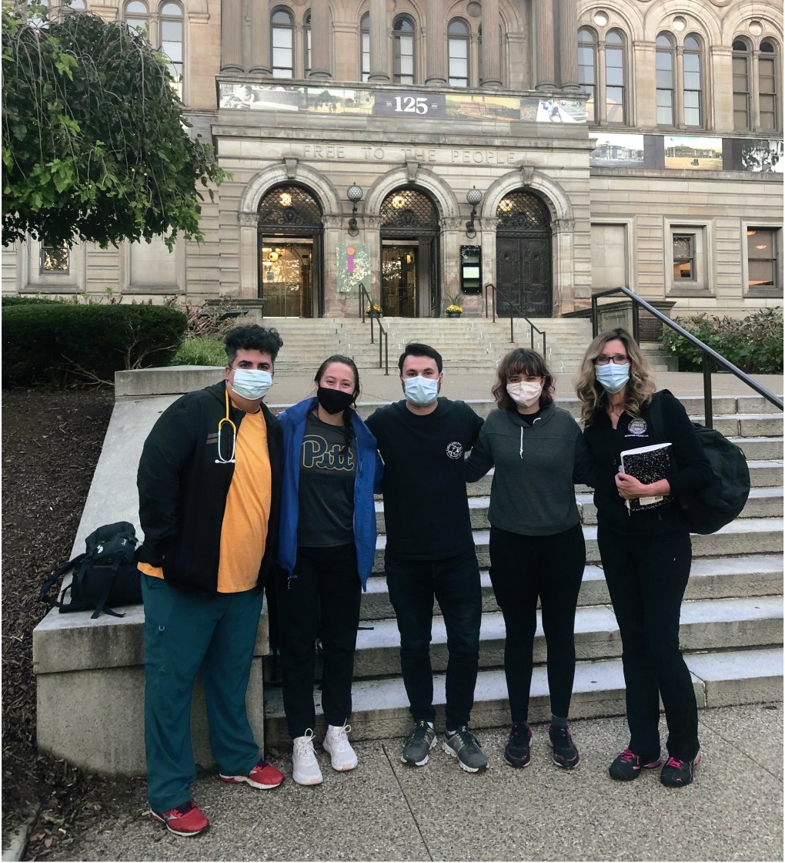

About Us
Founded in 2021 and inspired by Pittsburgh's rich history as the birthplace of street medicine
Current student membership has grown to over 400 general body members and over 70 street rounds volunteers.
Two core clinicians (Med-Peds, PM&R), student leadership board and advisors
Interdisciplinary and interprofessional: previous collaborations with Public Health, SHRS, Pharmacy, Dental, and Social Work.

Slide 3
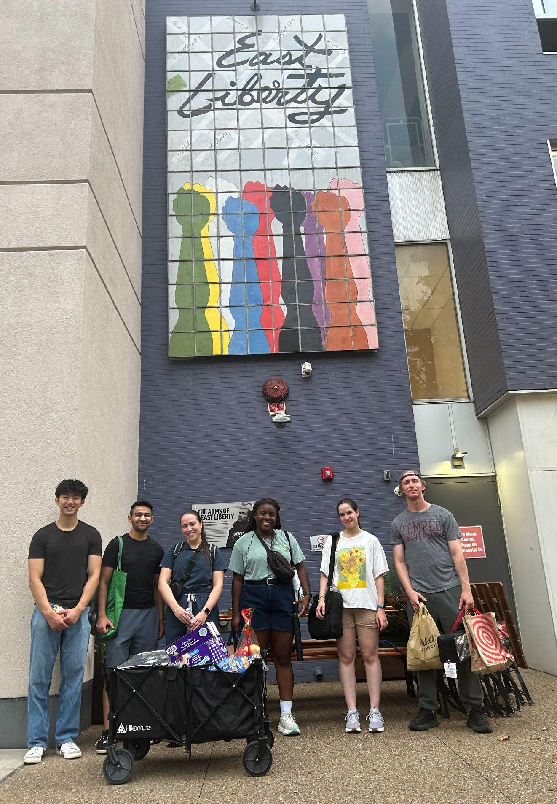
Our Values
1
Authentic, relationship-based care
2
Interprofessional teamwork
3
Lens of health equity

Slide 4




Student & Clinician Involvement:
Didactic Events
Community Volunteering
Street Rounds
Research

Slide 5
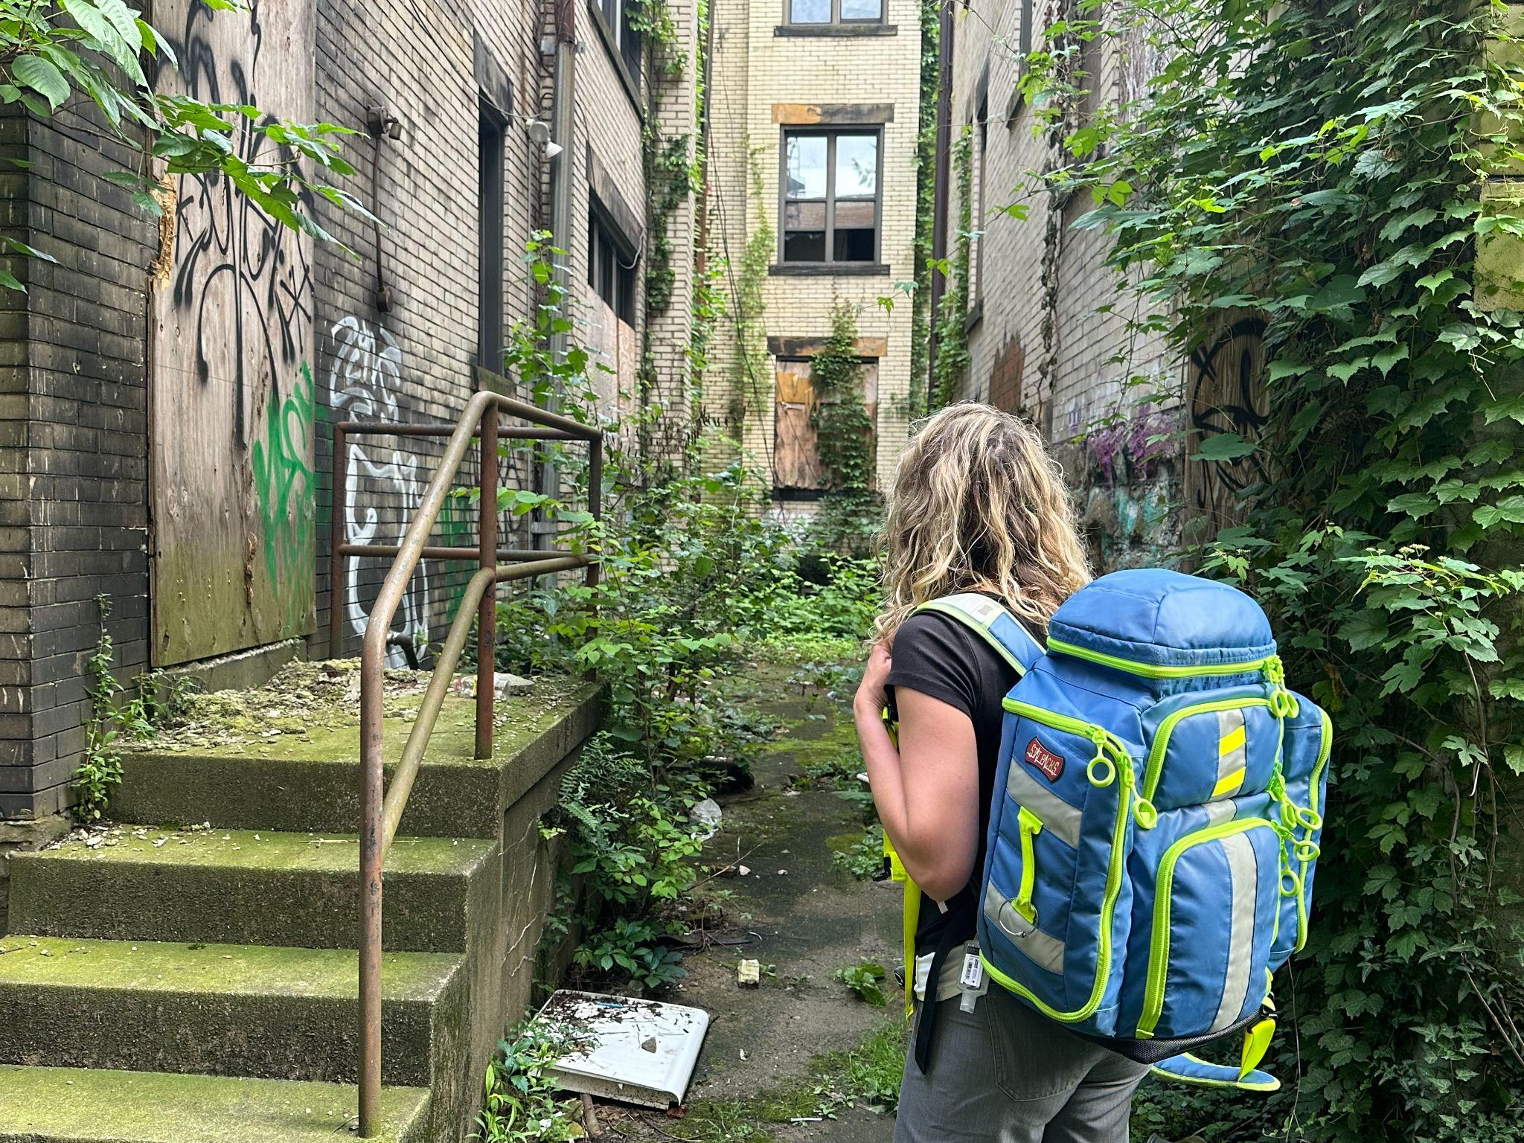
Street Rounds
Interdisciplinary healthcare outreach to provide medical care, basic needs, connection to resources, relationship and trust building to those experiencing unsheltered homelessness
Consists of walking through Pittsburgh (Downtown, Oakland, Shadyside, etc.) to meet with unsheltered individuals where they are instead of requiring them to come into clinic environments that may be inaccessible, stigmatizing, or traumatizing
Wednesday nights 6:30 -9 PM
Thursday Addiction Medicine 1:30-3:30 PM

Slide 6
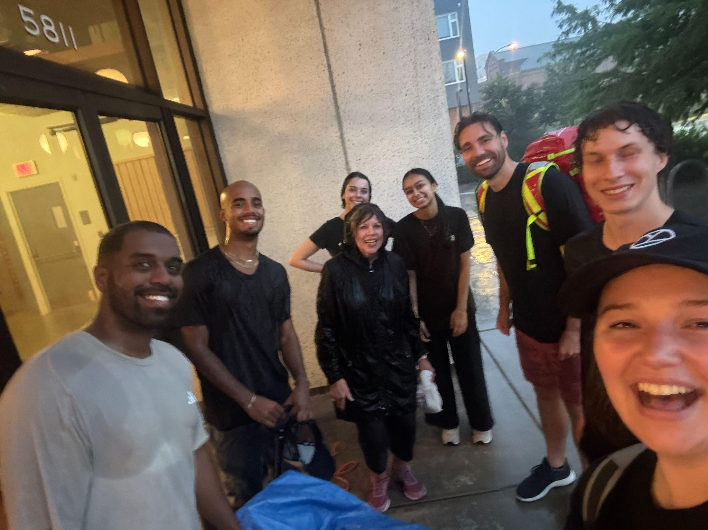
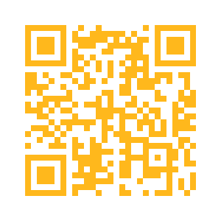
Current Street Rounds Onboarding
Orientation
Includes membership tracking, asynchronous video and quiz on street medicine values, best practices and safety guidelines: www.streetmedatpitt.org/orientation

Slide 7
Supply Coordination
Weekly Sam’s Club Runs for groceries
Pickups for locally sourced food and donations
Pitt Food Recovery Heroes
412 Food rescue
Ordering and seasonal donations for frequently used supplies
Volunteer to coordinate supplies when you have time and as many times as you would like (no onboarding)
For more information on joining the resource committee please reach out to info@streetmedicineatpitt.org

Slide 8
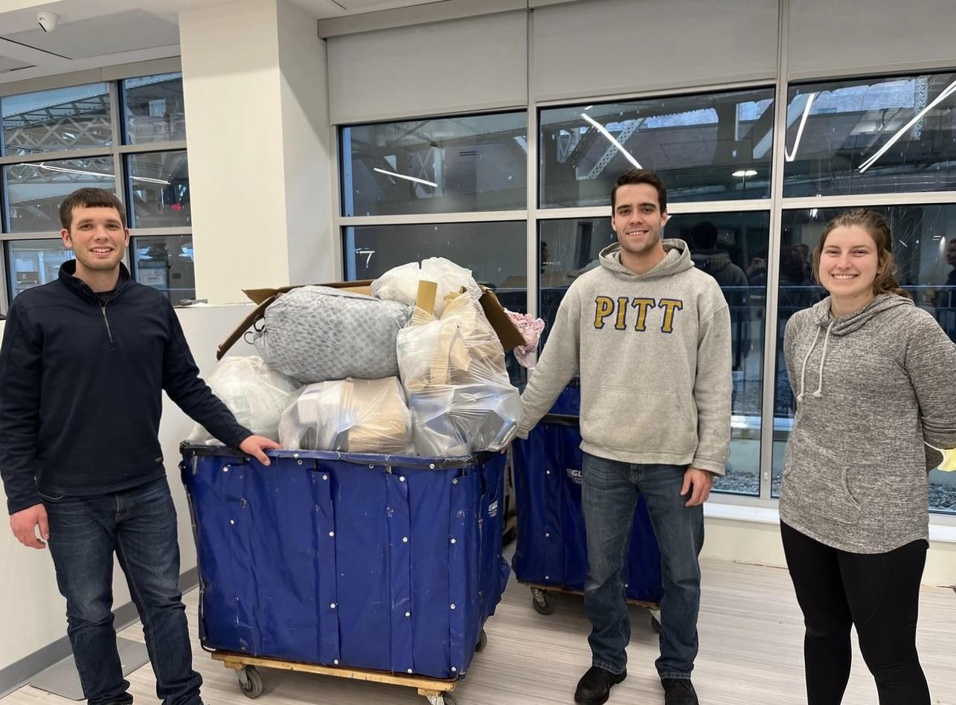
Volunteer Opportunities
Resource management (organizing donations)
Donation drives
Operation Safety Net warehouse
Community Partner Nights
Community Human Services food pantry
Making sandwiches/care
Fundraising

Slide 9

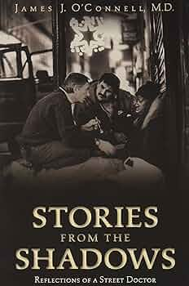
Didactic Events
Guest speakers
Panels
Workshops and trainings
Book club
Journal club **
Short film screenings
Service hours

Slide 10
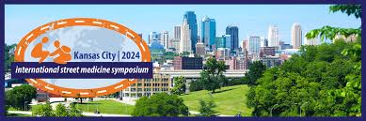
Research
History of ethical involvement in
Quality Improvement and Medical Education research
Open to collaborations with faculty and students interested in research that improves options for our clients
Opportunities to present findings
Requests for collaboration go through our dissemination form!
Email: info@streetmedatpitt.org
Ongoing topics of interest include:
Impact of a Street Medicine Consult Service, Lowering the barriers to buprenorphine access, Barriers to care in the ER

Slide 11
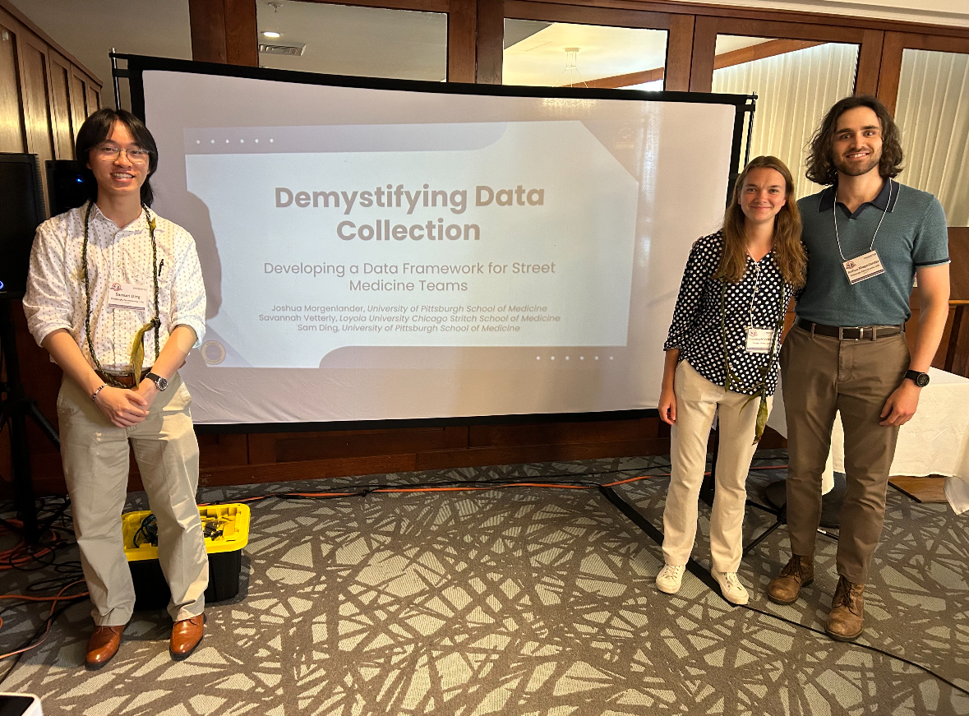
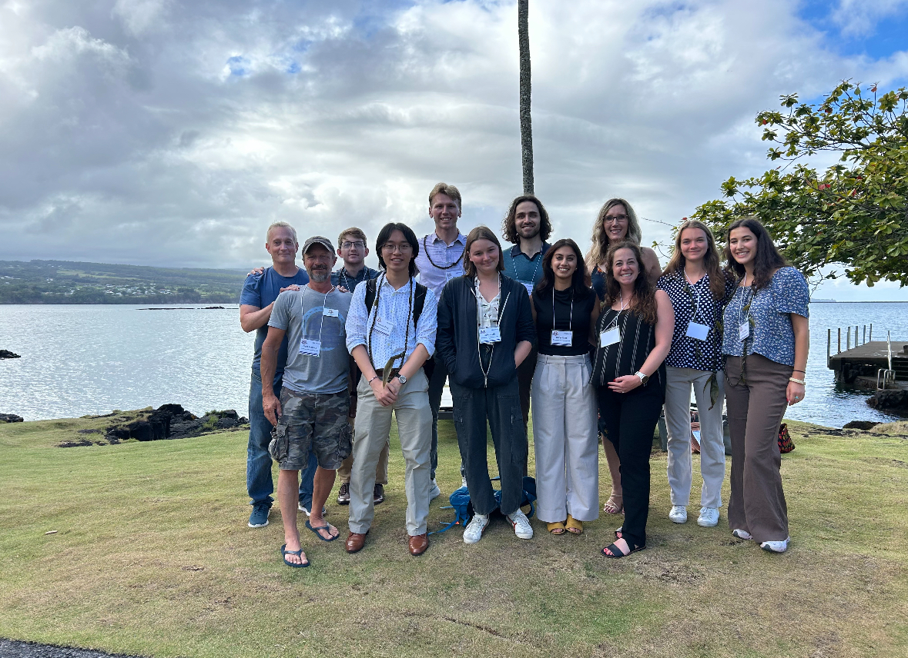
Recap of the International Street Medicine Symposium
What is the Street Medicine Institute?
ISMS: clinical topics, innovations, research outcomes, and best practices
Lectures, presentations, workshops
Hilo, Hawai’i, 2025.

Slide 12
Involvement so far from 26 areas of practice:
Health and Rehabilitation Sciences (SHRS)
Medicine
Public Health
Pharmacy
Social Work
Pediatrics
Internal Medicine
PM&R
Emergency Medicine
Addiction Medicine
Psychiatry
Family Medicine
Podiatry
Palliative Care
Med-Peds
Behavioral and Community Health Sciences
Health Policy and Management
Epidemiology
Occupational Therapy
Nutrition
Athletic Training
Emergency Medicine
Physical Therapy
Physician Assistant
Audiology
Dental
Nursing
Engineering
Undergraduate Studies
Nutrition

Slide 13
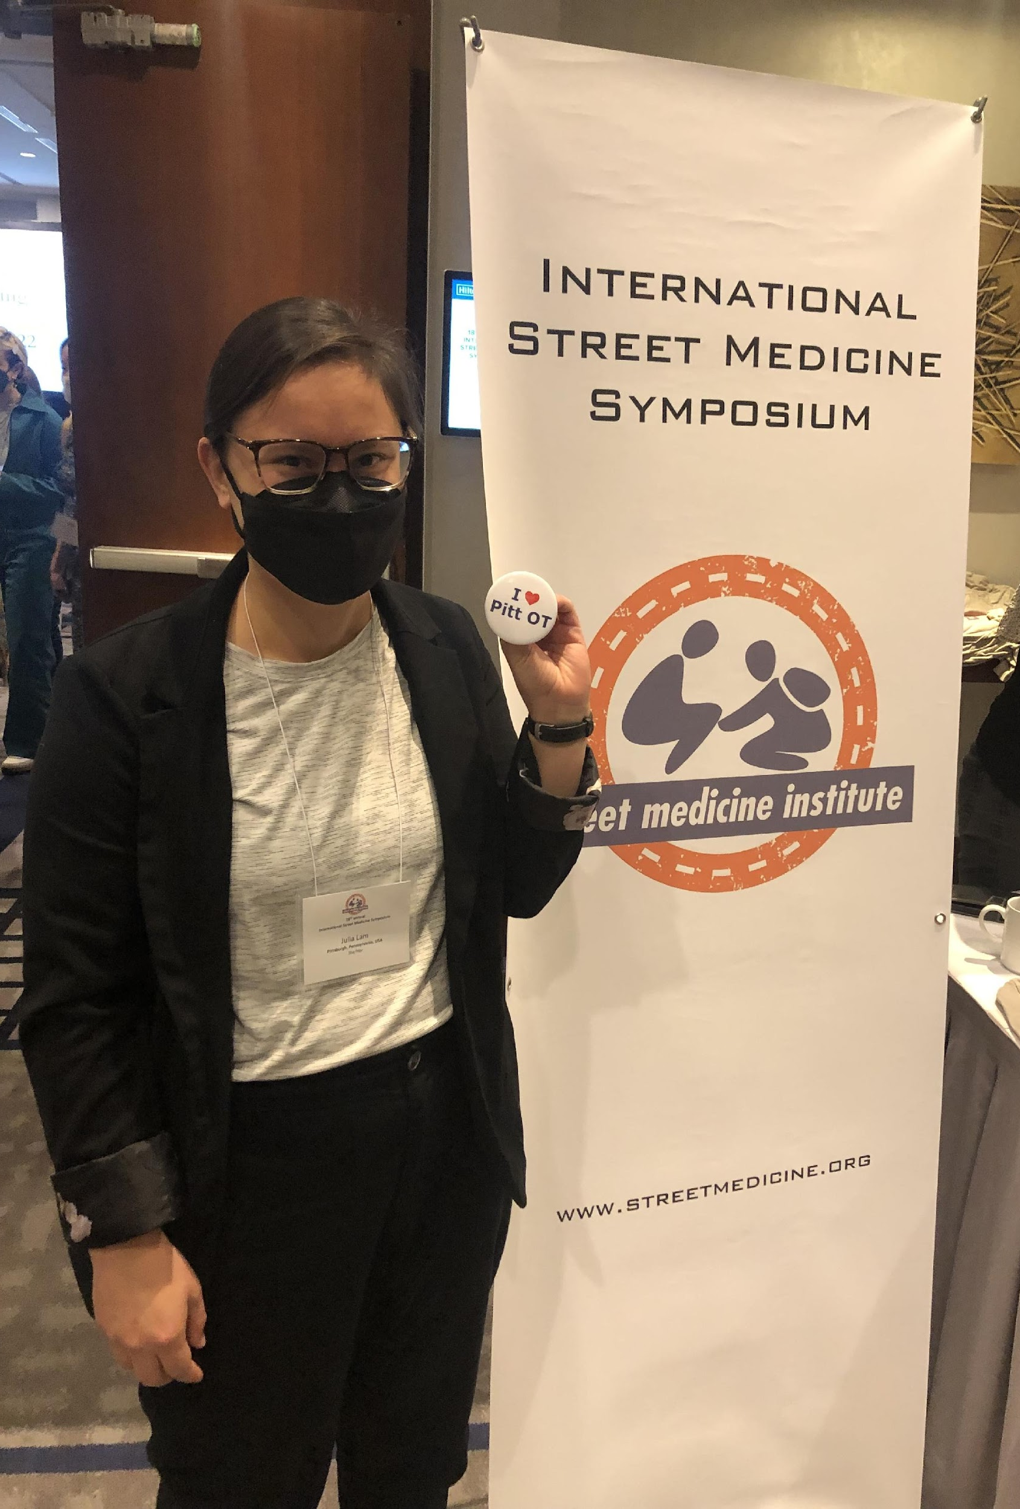
Participant Testimonies
“Each encounter was different, but equally rewarding. I appreciate that unlike traditional clinics, street medicine requires a greater degree of flexibility, problem solving, and empathy.”
Lee Varelas, MD, PGY-1
"My expectations were definitely met - maybe even exceeded. I was surprised by how it was more about material and food needs for folks. A lot of them just wanted someone to listen. A lot of folks also have a distrust of medicine (rightfully) and knowing that this is often the case for marginalized folks is always a good reminder. Definitely will be going on rounds again."
Street Rounds participant, September 2022

Slide 14
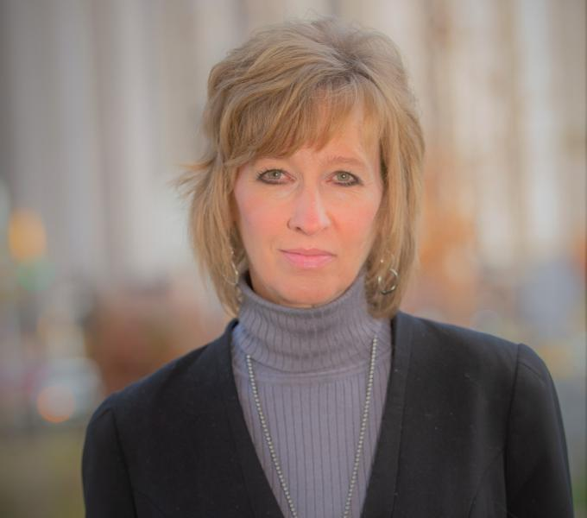

Fall Journal Club
When: September 25th 6:00 pm
Where: Public Health room A522
What: An open discussion led by Dr. Mary Hawk

Slide 15
Upcoming Events
Community Map Night: Tuesday, Oct. 14 at 6 pm WPU 540
Scenario Night: Tuesday, Nov. 11 at 6 pm WPU 527
Journal Club #2: Tuesday, November 18 at 6 pm WPU 539

Slide 16
Join Street Medicine at Pitt
Orientation
Includes membership tracking, asynchronous video and quiz on street medicine values, best practices and safety guidelines: www.streetmedatpitt.org/orientation
Interested in joining the board or volunteering?
Email info@streetmedatpitt.org

